Slide 1
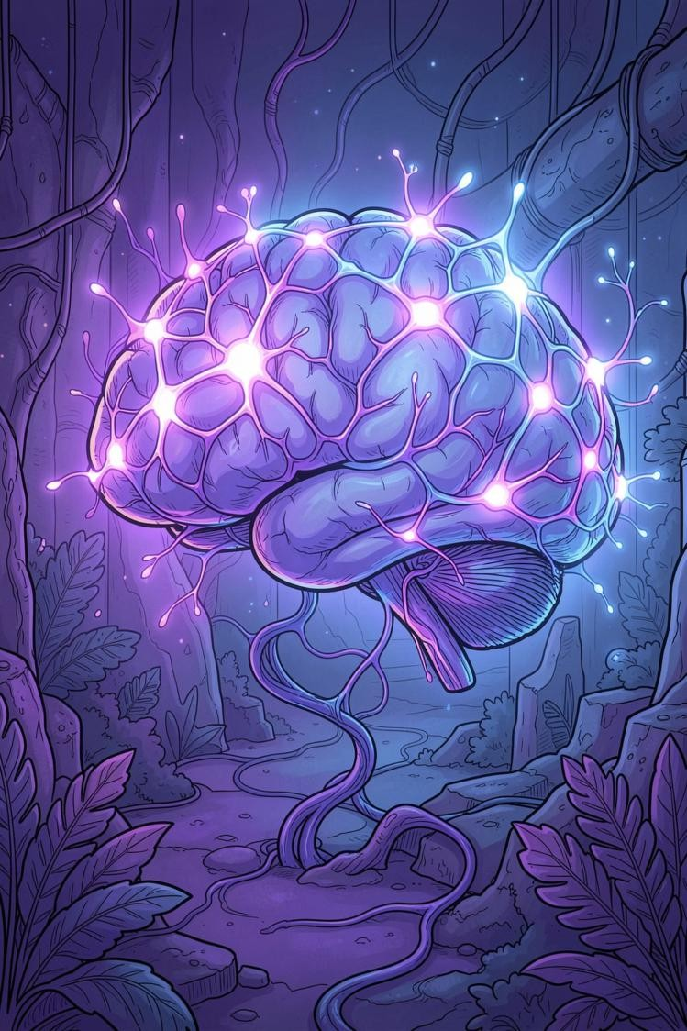

MindCare AI
An Emotion-Aware Mental Health Chatbot
Delivering Empathetic, Personalized Mental Wellness Support
UNDER THE SUPERVISION OF PROF. SUDIP DAS
PRESENTED BY
GARGI DAS (434124010044)
ARIJIT SASMAL (434124010056) MD MUFID ALAM (434124010046)

Slide 2

The Gap in Mental Health Support
Mental health care remains out of reach for millions — not because solutions don't exist, but because systemic barriers prevent people from accessing them. The problem is compounded by technology that promises help but fails to deliver genuine understanding.
Access Barriers
Social stigma, high therapy costs, and long waiting times prevent millions from
seeking or receiving professional mental health care when they need it most.
Robotic Chatbots
Existing mental health chatbots rely on simple keyword matching, producing
repetitive, generic responses that feel mechanical rather than supportive.
Emotional Blindness
Current tools fail to understand the user's emotional context, leaving individuals feeling unheard, unsupported, and ultimately disengaged from the experience.

Slide 3
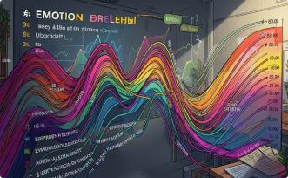

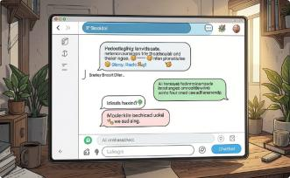
Introducing MindCare AI
MindCare AI is an intelligent, web-based mental wellness companion that bridges the gap between rigid rule-based bots and emotionally intelligent human support. By combining real-time emotion detection with a powerful generative language model, it delivers responses that feel genuinely empathetic and contextually appropriate.
Real-Time Emotion Detection
Analyzes user input in real-time to detect
emotional state, enabling the system to
respond with appropriate empathy and care.
Fine-Tuned DistilBERT Model
A transformer-based emotion classifier fine-tuned on over 100,000 labeled utterances, delivering high accuracy with sub-second inference.
Meta LLAMA 3.1 70B
Integrates a state-of-the-art large language model via OpenRouter API to generate nuanced, context-aware, and supportive replies.

Slide 4
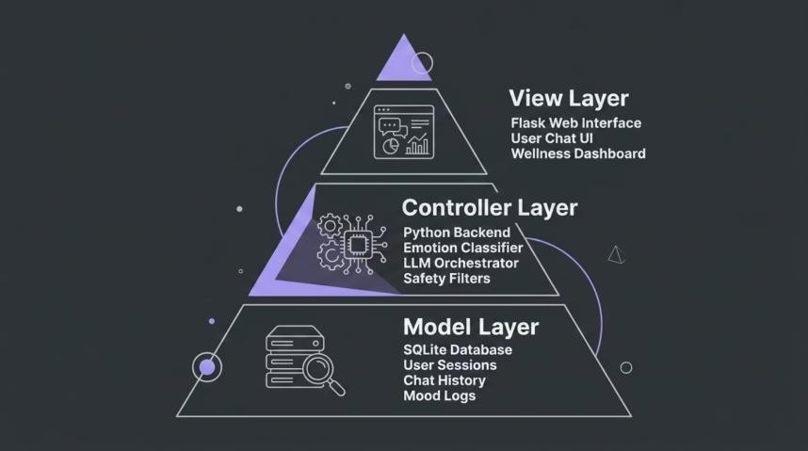
Under the Hood: Architecture & Tech Stack
MindCare AI is built on a secure, scalable Model-View-Controller (MVC) architecture that cleanly separates concerns across the presentation, business logic, and data layers. This design ensures maintainability, testability, and a clear path for future feature expansion.
Backend & Database
Python 3.13
Flask web framework
SQLAlchemy ORM
SQLite database
AI & NLP Stack
PyTorch deep learning framework
HuggingFace Transformers
DistilBERT base uncased
OpenRouter API (LLAMA 3.1 70B)

Slide 5






Understanding How Users Feel
EMOTION DETECTION MODULE
The emotion detection module is the cognitive core of MindCare AI. It classifies every user message into one of six emotional categories, enabling the system to tailor its tone, empathy level, and response strategy accordingly. High accuracy and low latency were both critical design requirements.
Training Data
The model was trained on a merged, balanced dataset of over 100,000 labeled utterances, combining the GoEmotions dataset with the dair-ai/emotion corpus for broad emotional coverage.
Joy
Love
Sadness
Anger
Fear
Neutral
Performance
Achieves 73.14% classification accuracy with sub-second inference times on standard CPUs — making it suitable for real-time conversational deployment.

Slide 6

Delivering Empathetic Responses
EMOTION-AWARE RESPONSE GENERATION
Once an emotion is detected, MindCare AI doesn't just reply — it responds with intention. The detected emotion label is injected directly into the LLM's system
prompt, instructing Meta LLAMA 3.1 to adopt the role of a supportive mental health companion calibrated to the user's current emotional state.
User Input
User sends a message through the chat interface
Emotion Classification
DistilBERT detects the emotional category in real-time
Prompt Engineering
Emotion label is embedded into the LLM system prompt
Empathetic Reply
LLAMA 3.1 generates a context-aware, supportive response
Conversation memory is maintained across turns, ensuring replies flow naturally and match the user's evolving emotional tone throughout the session.

Slide 7


Beyond Chat: Analytics & Protection
WELLNESS DASHBOARD & SAFETY
MindCare AI extends well beyond the conversation window. A dedicated wellness dashboard helps users track their emotional patterns over time, while a robust safety layer ensures that crisis situations are handled with care and urgency — before any AI response is even generated.
Wellness Dashboard
14-day mood trend chart visualizing emotional patterns over
time
Daily mood check-ins to encourage self-reflection Personalized wellness tips based on detected emotional trends
Exportable chat history in TXT and CSV formats
Safety First
Strict keyword filters instantly detect crisis language or harmful content
At-risk users are immediately redirected to the AASRA helpline
Safety protocols trigger before the LLM processes the message
Explicit content is filtered to maintain a safe conversational
environment
•
•
•
•
•
•

Slide 8


Upgrades from the Minor Project
MAJOR PROJECT ENHANCEMENTS
The major project represents a significant leap forward from the initial minor project prototype. Through model improvements, dataset augmentation, and entirely new feature modules, MindCare AI has evolved from a basic emotion classifier into a full-featured mental wellness platform.
Model Accuracy: +15.64%
Classification accuracy improved from 57.50% to 73.14% by upgrading to the v3 DistilBERT model and augmenting the training dataset with additional labeled utterances.
New Analytics Dashboard
A full wellness dashboard was added, featuring a 14-day mood trend chart, daily mood logging, and personalized wellness recommendations based on user history.
Data Export Capability
Users can now export their complete chat history in both TXT and CSV formats,
enabling personal record-keeping and
potential integration with healthcare providers.

Slide 9
System Validation
TESTING & RESULTS
Rigorous testing was conducted across all system components — from the emotion classifier and LLM response quality to the multi-user authentication system and safety protocol triggers. Results confirm that MindCare AI meets its core design objectives with strong, measurable outcomes.
73.14%
Emotion Classification Accuracy
Achieved on the held-out test set using the v3 DistilBERT model
50
Sample Interactions Reviewed
Qualitative review confirmed contextually congruent, empathetic responses
100%
Crisis Message Interception
All test crisis messages successfully triggered safety protocols and helpline routing
The complete multi-user account system — including secure password hashing, session management, and persistent data storage —
was validated to work flawlessly across concurrent user sessions.

Slide 10


Looking Ahead
CONCLUSION & FUTURE SCOPE
MindCare AI successfully demonstrates that emotionally intelligent, AI-powered mental wellness support is achievable with modern NLP techniques. It bridges the critical gap between rigid rule-based chatbots and genuinely empathetic conversational companions.
 | Multilingual Support Extend emotion detection and response generation to multiple languages using mBERT or XLM-ROBERTa, making MindCare AI accessible to non-English speakers globally.
 | Mobile Application Develop a native mobile experience using React Native, enabling on-the-go access to mental wellness support with push notifications for daily mood check-ins.
 | CBT Integration Incorporate formal Cognitive Behavioural Therapy (CBT) techniques into AI system prompts, enabling structured therapeutic conversations grounded in evidence-based practice.

Slide 11
THANK YOU

